Slide 1
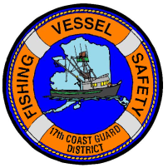
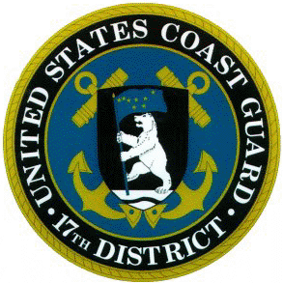
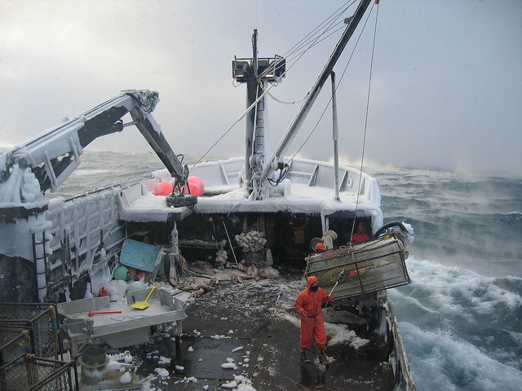
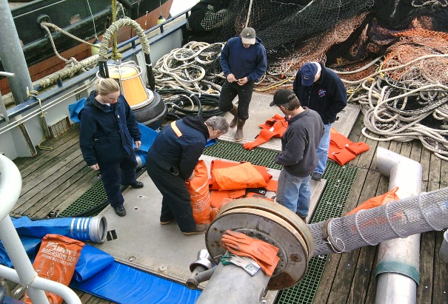
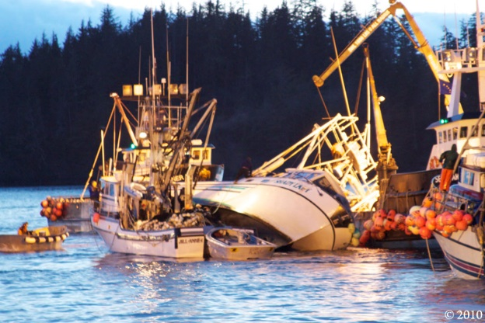
USCG DISTRICT 17 COMMERCIAL FISHING VESSEL SAFETY OVERVIEW
Mr. Scott Wilwert
Commercial Fishing Vessel Safety Program Manager
NCFSAC April 2024

Slide 2
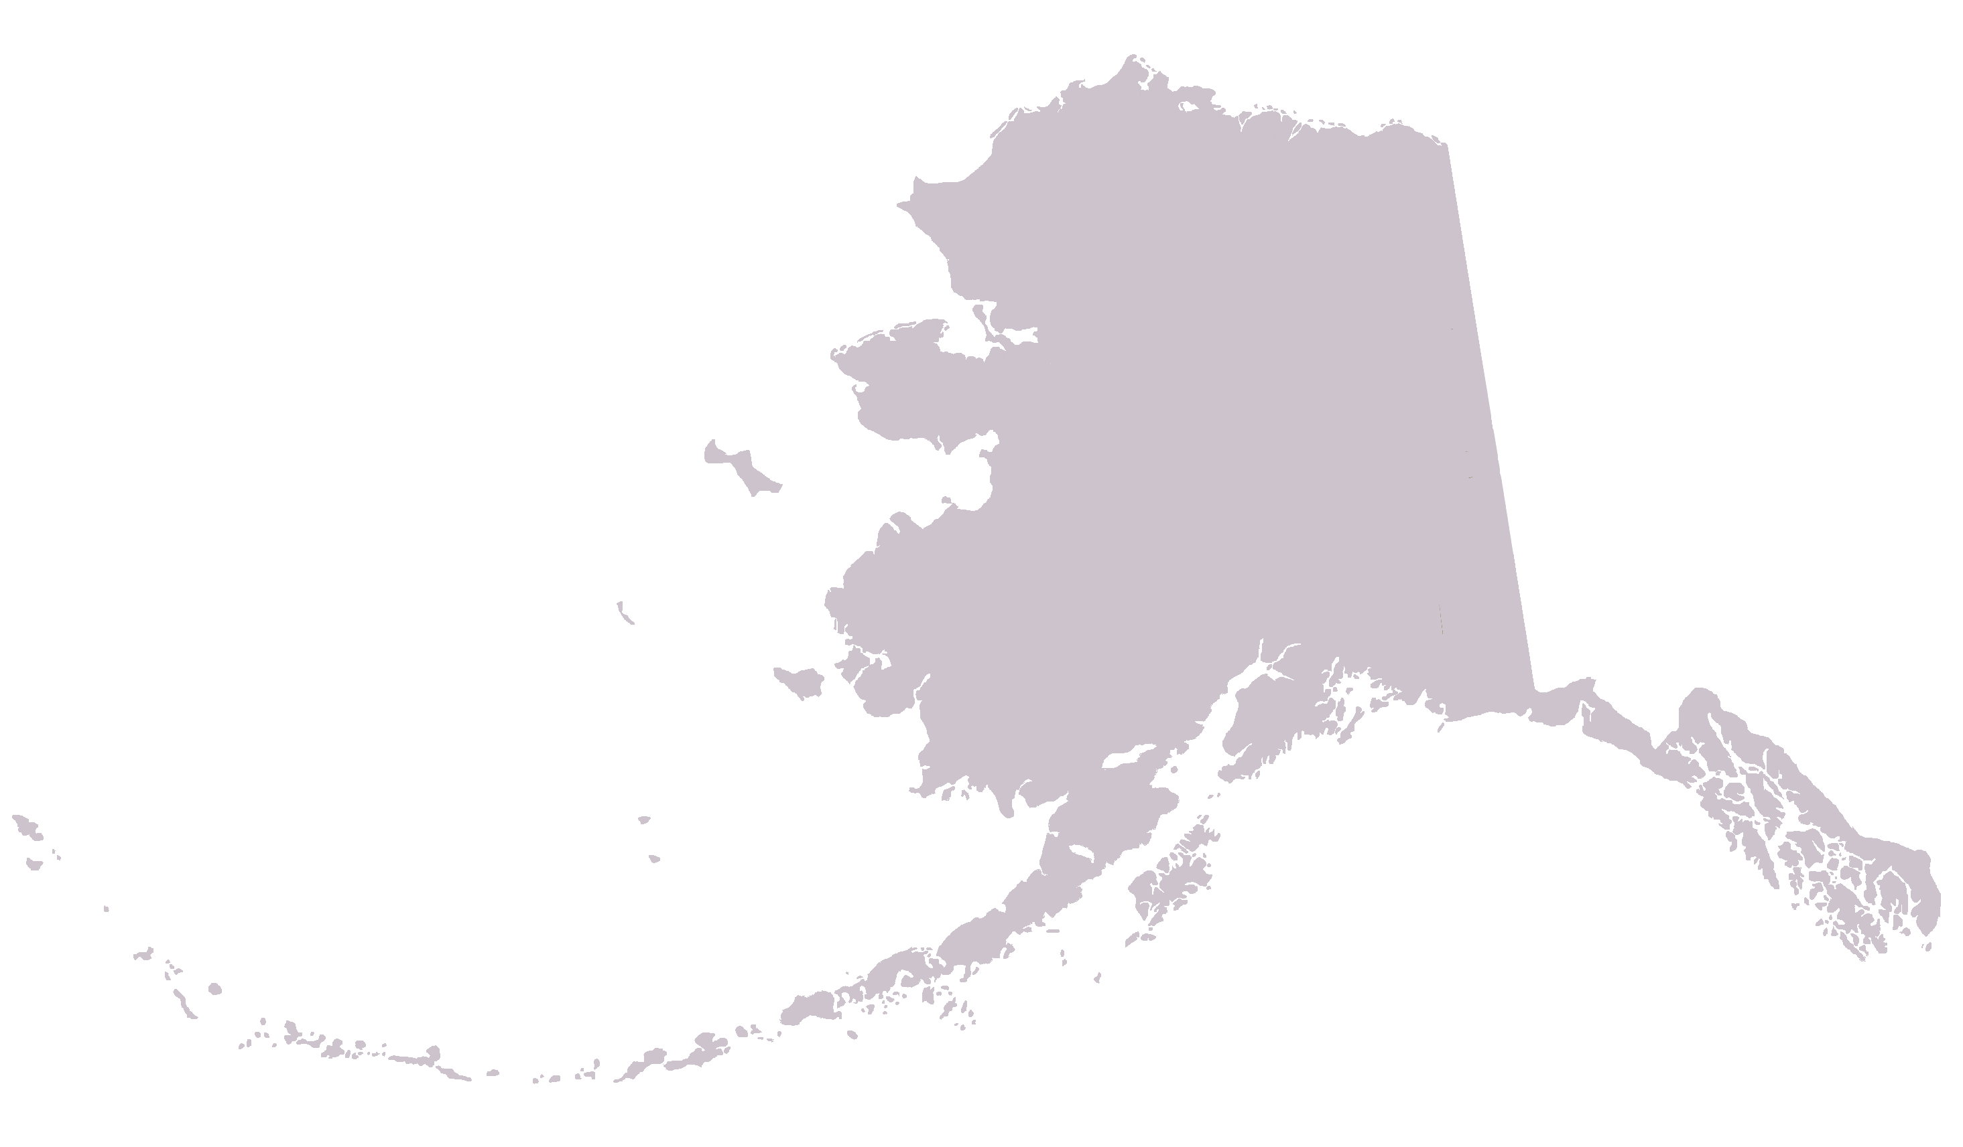
Typical Annual Outreach Visit Locations – 30+ Communities
CY-23 Exams conducted in D17: 1460
Challenges:
-Geography
-Weather
-Seasons
Challenges:
Geography
Weather
Seasons
Kotzebue
Savoonga
Nome
Golovin
Shaktoolik
Unalakleet
Toksook Bay
Mekoryuk
Bethel
Whittier
Yakutat
Quinhagak
Kenai
Cordova
Haines
Hoonah
Dillingham
Elfin Cove/Pelican
St. Paul
Petersburg
King Salmon/Naknek
Wrangell
Egegik
Metlakatla
Port Heiden
Port Moller
Chignik
Craig/Klawock/Coffman Cove/ Thorne Bay/
Hydaburg
King Cove
Sand Point
Dutch Harbor
Regular exams conducted in communities with full-time USCG Examiner presence:
(i.e. Juneau, Ketchikan, Sitka, Seward, Valdez, Homer, Kodiak, Dutch Harbor etc..)

Slide 3
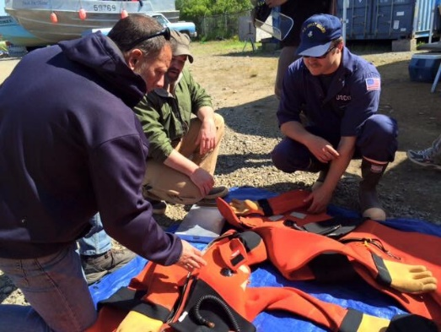
D17 CFVS Examiners Locations
MSU Valdez – 7
7- Active Duty
Cordova – 1
1- 3rd Party Surveyor
Juneau – 9
2- Civilian
7- Active Duty
Sector Anchorage – 12
1- Civilian
9- Active Duty
1- 3rd Party Surveyor
1- Auxiliary
MSD Homer – 4
4- Active Duty
USCG DD Seward - 1
1- Active Duty
MSD Dutch Harbor – 7
7- Active Duty
MSD Kodiak - 5
1- Civilian
4- Active Duty
MSD Sitka – 5
1- Civilian
2-3 - Active Duty
2- 3rd Party Surveyors
D17 Qualified CFVE Personnel:
1- Civilian Program Manager
5- Civilian Examiners
49- AD/AUX/TPO
Total – 55
MSD Ketchikan - 3
1- Civilian
2- Active Duty
Notes:
Discuss relationship/dynamic when comparing units with dedicated civilian CFVS examiners and units with only Active Duty examiners. Neither good or bad, just different mindset and time to dedicate to the CFVS mission.

Slide 4
Man Overboard
Challenges:
Geography
Weather
Seasons
Kotzebue
Vessel Disaster / Capsizing
Onboard Accident / Fire
Dive Harvest
5
Homer
Juneau
St. Paul
Dillingham
6
Ketchikan
5
King Cove
Dutch Harbor
Fishing Vessel Fatalities 2011-2023 – (71)
Engaged in federal fishery – 22
Engaged in state fishery - 49
Notes:
Destination / Scandies Rose
Enforcement fed fisheries vs. state

Slide 5
OPERATIONAL FATALITIES IN ALASKA BY DECADE 1990-2023
Significant Dates:
Sep 1991 – CFVS Act/Regulations
Mar 1995 – Halibut/Sablefish IFQ’s
Oct 1999 - Bering Sea Crab Stability Compliance Checks
Oct 2005 – BSAI Crab Rationalization
2006 –Alternate Compliance Safety Agreement
Oct 2015 – USCG Mandatory Dockside Exams
2022 – Increased Focus on Stability
Notes:
Mention current fatalities from 2020 only a 4 year period

Slide 6
OPERATIONAL FATALITY RATE PER 10,000 VESSELS

Slide 7
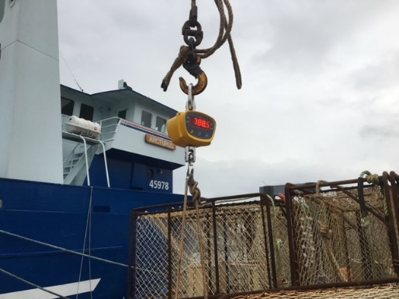
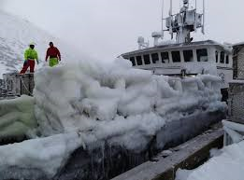
AK- NOMOLIES
ACSA
Fish Tender Barges
Infant Immersion Suit Non-Enforcement
SEAK Survival Craft Exemption
SEAK Mandatory Exam Exemption (inside)
Fleet Exemptions (set net, Bristol Bay etc..)
“Dude Fishing”
Pot Weighing / Stability Compliance Checks

Slide 8
ALASKA COMMERCIAL FISHING INDUSTRY
Approx. 8500 permitted commercial fishing vessels
Employing 30,000 fishermen and 26,000 processors
$2.1 Billion annual labor income
$5.6 Billion in total economic activity
Notes:
Fleet size ranges from set net skiffs to 300’ processors and motherships.
Define “operational fatality” and where the fatalities are coming from.

Slide 9
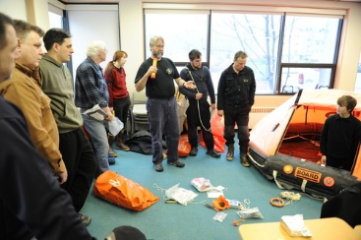
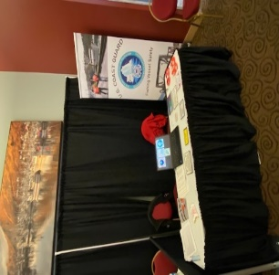
SOME UPCOMING EVENTS
Immersion Suit Study w/NIOSH
Fish Tender / Load line Issue
Inspected Fish Tender Barges
ADFG MOA Implementation
Kodiak COMFISH (Apr 2024)
Industry Day (May 2024, Homer, AK.)
MSD Dutch Harbor training trip (Aug 2024)
Annual CFVS Training Academy (Sep 2024)
Bering Sea Crab Stability Outreach (Oct 2024)
Pacific Marine Expo (Nov 2024)

Slide 10
USCG DISTRICT 17 CFVS TRAINING / INDUSTRY ENGAGEMENT
Association Meetings
National Fishing Safety Advisory Committee
AMSEA/NPFVOA
Letters of Support
Board of Directors seat
Local Industry Day’s
Flooding control trainer
Expos/Tradeshows
Pacific Marine Expo
Bristol Bay Expo
Comfish Kodiak
Stability/Pot Weighing Initiative
NOAA/ADFG MOA’s
Fishsafewest.info
Media/Social Media
Articles
Interviews
Radio
Television
USCG Examiner Training Academy
Industry guest speakers
Notes:
Stress positive relationship between the USCG and the commercial fishing industry. High rate of compliance/participation in dockside exams (now and before it was mandatory for some).

Slide 11
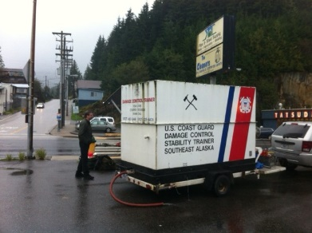
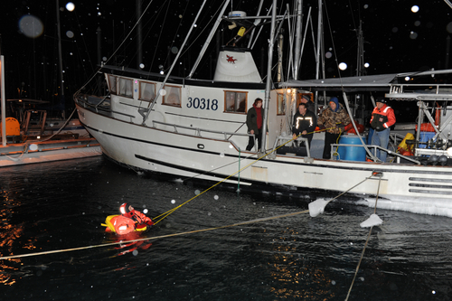
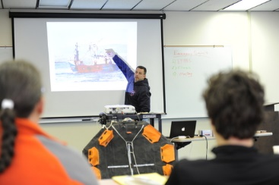
Deliverables
National Communications Plan (Quarterly to CVC-3)
MISLE (Closed cases / Error free / Review 10-20%)
Bering Sea Crab List (Seasonal)
CFVS Decal Lists
At Risk Vessels
Casualty/Fatality Stats (As request)
CFVE Training (Annual/ As Needed)
GAO Program Audit (Tender Load Line)
Updates to Industry (Whenever we can)
Testimony (When Required)

Slide 12
Questions??

